Slide 1
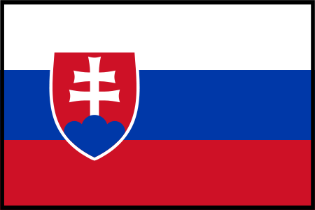
Our country - Slovakia

Slide 2
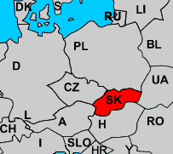
About Slovakia
Slovakia is a small country situated in Central Europe.
The area of Slovakia is 49 035 km²
Slovakia borders with the Czech Republic, Poland, Ukraine, Hungary and Austria.

Slide 3
Population
5,4 million people live in the Slovak republic
Ethnic groups :
85.8% Slovaks, 9.7%
Hungarians ,
1.7% Gypsies
2.8% other minority groups
Religion :
Roman catholic, 68,9 %
Evangelistics 7 %
Without religion 13%
Greek catholic 4,1 %

Slide 4
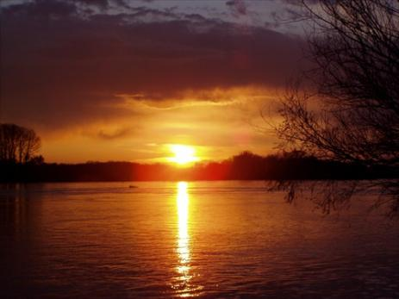
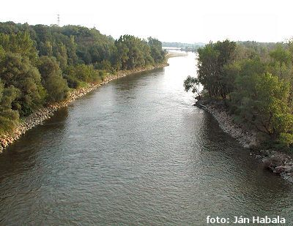
Rivers
The Váh“ is the longest river in Slovakia (403km), it springs from „Nízke Tatry.“
The Danube is the biggest river in the Slovak republic (47 100 km²) but it springs from Germany.
Other rivers :„Hron, Morava, Hornád, Ipelˇ, Nitra, Tisa, Dunajec, Poprad. “

Slide 5
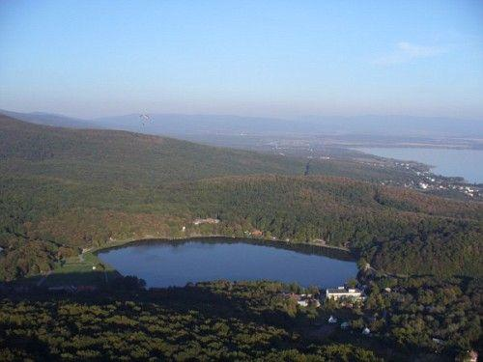
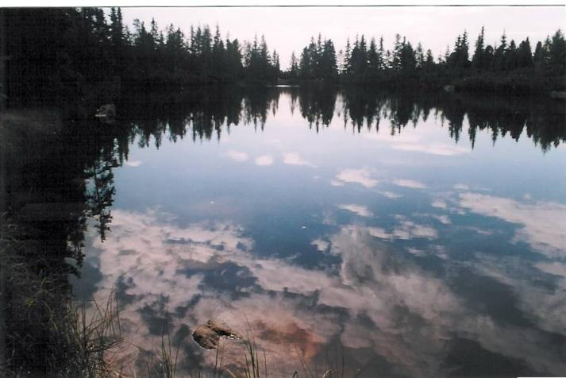
Lakes
„Veľké Hincovo pleso“ is the biggest lake in the Slovak republic (20,08 hectare ) .
Other lakes : Štrbské pleso, Popradské pleso, Skalnaté pleso , Morské oko.

Slide 6
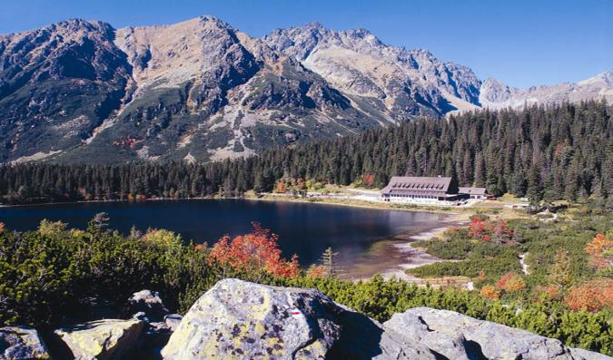
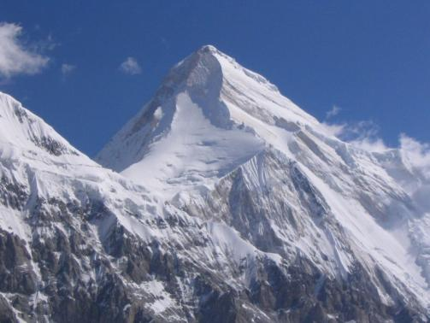
Mountains
High Tatras are the highest mountains in Slovakia .
The Highest mount in Slovakia is
„Gerlachovský štít“ ( 2654,4 m )
The Lowest place in Slovakia is „Brázda“ ( -180.5m)

Slide 7
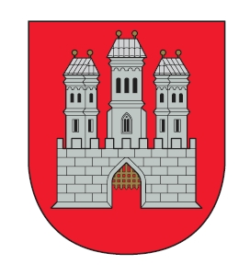
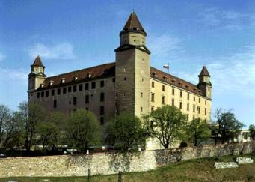
Bratislava The Capital city of Slovakia
Bratislava is the political, cultural and economic centre of Slovakia. It is the seat of the Slovak president, the parliament, and the executive branch of the government. It is home to several universities, museums, theatres, galleries and other important economic, cultural institutions .

Slide 8
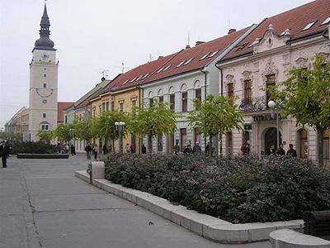
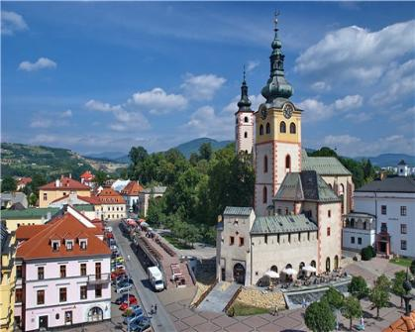
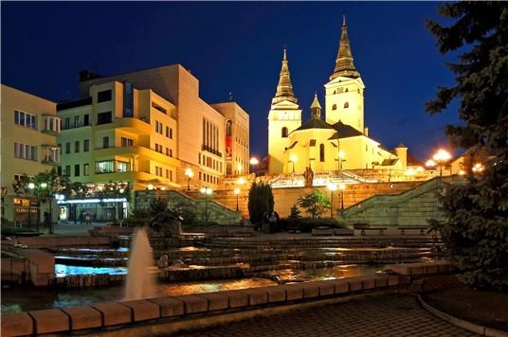
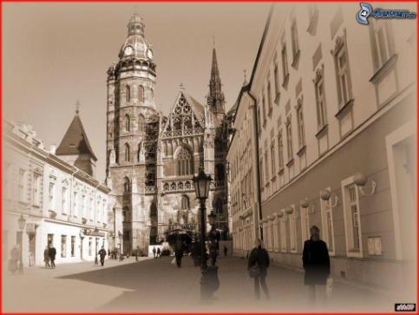
Other cities
The biggest city is Bratislava, the next one is Košice, žilina, Trenčín, Martin, Poprad, Komárno, Banská Bystrica, Nitra, Trnava ...

Slide 9
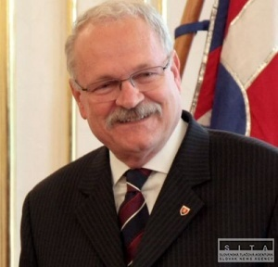
President
The Slovak head of state is the president (Ivan Gašparovič, 2004 - 2009), elected by direct popular vote for a five-year term.
Robert Fico is the prime minister. He is head of parliament.
Our president

Slide 10
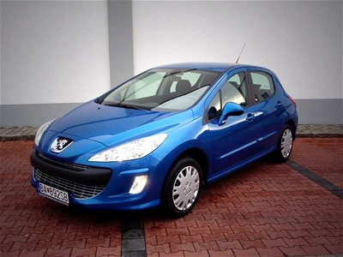
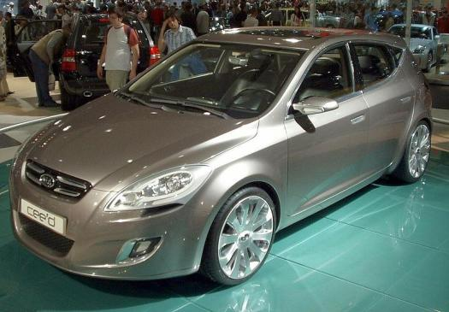
Industry
There are currently three car manufacturers: Volkswagen in Bratislava, PSA Peugeot , Citroen in Trnava and Kia Motors in Žilina.
From electrical engineering companies, Sony has a factory in Nitra for LCD TV manufacturing , Samsung in Galanta for computer monitors and television sets.

Slide 11
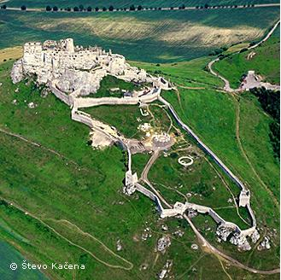
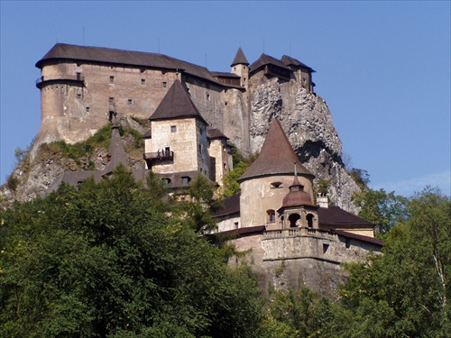
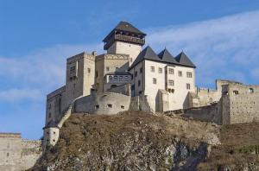
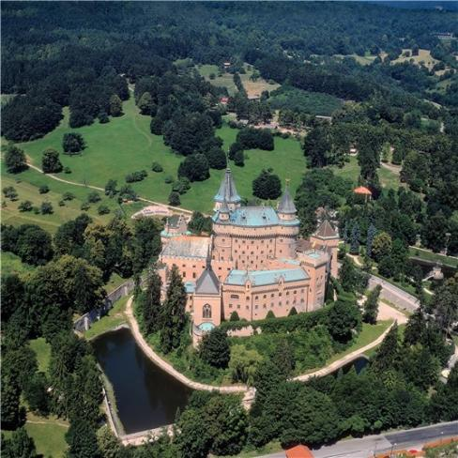
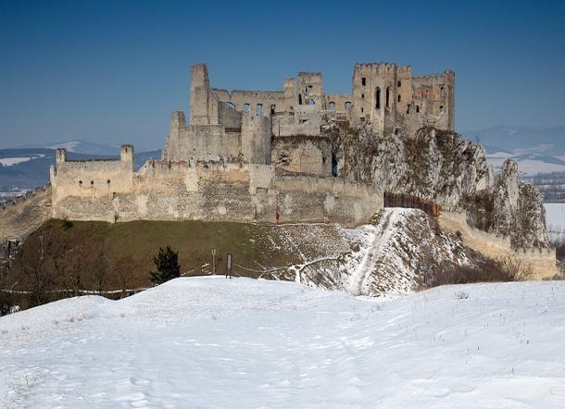
Castles

Slide 12
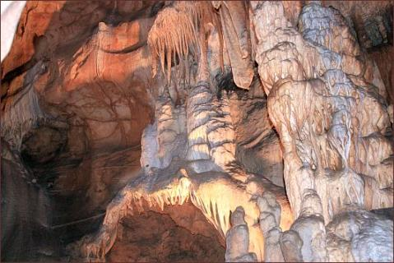
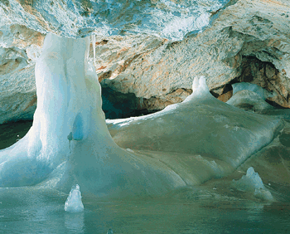
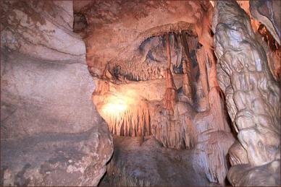
Caves
The biggest cave is „Dobšinská ľadová cave „
capacity of ice : 110,132 m3…
depth of ice : 26,5 m

